Slide 1
Financing Municipal Investments in Sustainable Energy Support from the European Commission
Conference “Innovative Financing of Energy Efficiency Projects”
13 May 2021
Björn ZAPFEL Senior Project Expert CINEA - LIFE Energy & Climate Unit

Slide 2
European Climate, Infrastructure and Environment Executive Agency (CINEA)
Key contribution to European Green Deal
Implementing the new portfolio will support the European Green Deal - the roadmap for making the EU’s economy sustainable
Boosting the efficient use of resources by moving to a clean circular economy, restore biodiversity, cut pollution, and achieve climate neutrality by 2050

Slide 3
Climate and Energy Framework
Climate & Energy Framework 2020
Climate & Energy Framework 2030 (incl. “Long-term renovation strategies”)
Clean Planet by 2050: net-zero GHG emissions
European Green Deal: first climate-neutral continent (incl. “Renovation Wave”)
2050
2030
2020
Investment Gap
Huge potential of Cities/Municipalities for sustainable energy investments
Pipeline building
Aggregation
Finance mobilisation

Slide 4
Project Development Assistance (PDA) under Horizon 2020 and Intelligent Energy Europe (IEE)
Build technical, economic and legal expertise needed for project development
Aggregate (pooling, bundling) projects to reach critical size
Mobilise private finance (incl. blending)
Develop organisational innovations and minimise transaction costs
High leverage and replicability

Slide 5
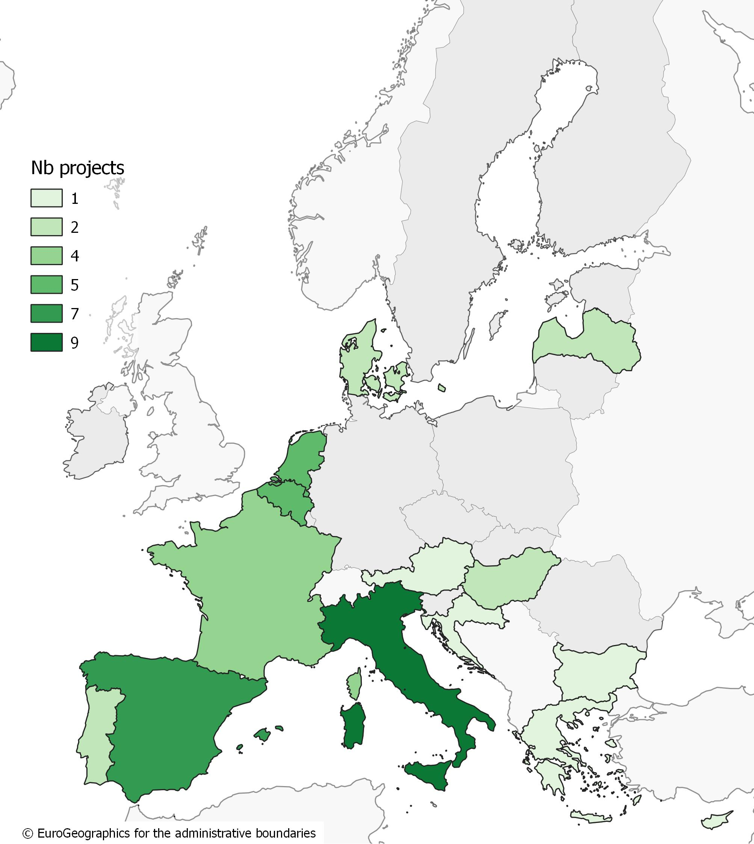
PDA status
47 funded projects + 5 under signature
Expected investments into sustainable energy of almost €1.1bn of which nearly €500m delivered
Innovative financing solutions: Forfaiting fund (SUNSHINE, LV) On-tax financing (EuroPACE, ES) Bundling and blended funds (MARTE, IT; PRODESA, EL) Energy Performance Tenancy Agreement (LEMON, IT)

Slide 6
European City Facility (EUCF) under Horizon 2020
Development
Implementation
Finance
Banks (incl. National Promotional Banks) and Investment Funds
ESCOs, EPC
Local & regional long-term energy & climate strategies
European City Facility
One-stop-shops
Investment concepts
ELENA – PDA
Technical Assistance
Financing Platforms
Lump sums (EUR 60,000) (investment concepts within limited time)
Regular Calls (quick & easy application/evaluation)
Country Experts & National City Networks (for local support & promotion)
EU and other public funds
Missing capacity to transform long-term strategies (e.g. SEAPs)
Limited resources to access (financial and legal) expertise
(or other)

Slide 7
EUCF status
1st Call: 257 applications from all EU-27 + UK
2nd Call with increased resources: 29 March - 31 May
Financial support and local services to large number of cities/municipalities
Fast-track, tailor-made, simplified lump sums
> 200 investment concepts
Mobilisation of significant investments (incl. combination with EFSI, ESIF, PDA/ELENA, investment platforms)
eucityfacility.eu

Slide 8
EU funding landscape to support energy efficiency
For Direct Investments
- Recovery and Resilience Facility
- Cohesion Policy Funds (ERDF, ESF)
- Just Transition Mechanism - JTF
For Technical Assistance and Advisory
- ELENA Facility
- Technical Support – Cohesion Policy
To leverage private investments
- InvestEU (Sustainable Infrastructure window and SMEs window)
For Research & Innovation
- Horizon Europe
To address Market Barriers
- LIFE – Clean Energy Transition & Climate Change Mitigation and Adaptation
- LIFE – Circular Economy & Quality of Life

Slide 9
LIFE - Clean Energy Transition (CET)
Continuation of market uptake Coordination and Support Actions under Horizon 2020-Energy Efficiency
7 years budget of almost €1 bn
Key objective: creating market & regulatory enabling conditions for the clean energy transition – focus on non-technological aspects
Contributing to the shift to a circular, energy-efficient, renewable energy-based, climate resilient economy
First Calls expected to be launched in June 2021
https://cinea.ec.europa.eu/life/clean-energy-transition_en

Slide 10
Areas of intervention for Clean Energy Transition
AREAS OF INTERVENTION
Building a national, regional and local policy framework supporting the clean energy transition
Accelerating technology roll-out, digitalisation, new markets, services and business models and enhancement of the related professional skills on the market
Attracting private finance for sustainable energy
Supporting the development of local and regional investment projects
Involving and empowering citizens in the clean energy transition

Slide 11
More information
LIFE-CET CINEA website: https://cinea.ec.europa.eu/life/clean-energy-transition_en
European infoday on the call topics (to be announced soon)
Funding portal: https://ec.europa.eu/info/funding-tenders/opportunities/portal/screen/programmes/life
Covenant of Mayors Investment Forum - Energy Efficiency Financing Market Place – 15-16 June 2021: https://ec.europa.eu/info/events/sustainable-energy-investment-forums/covenant-mayors-investment-forum-energy-efficiency-finance-market-place-2021-jun-15_en
@CleanEnergy_EU, @LIFEprogramme
European Climate, Infrastructure and Environment Executive Agency
CINEATube

Slide 12
Thank you very much!
© European Union 2021
Unless otherwise noted the reuse of this presentation is authorised under the CC BY 4.0 license. For any use or reproduction of elements that are not owned by the EU, permission may need to be sought directly from the respective right holders.

