Slide 1


The Central Union of Municipalities in the framework of KALLIKRATIS Administrative Reform

Slide 2
Structure of the presentation
Part Α: Historical overview of KEDKE
1927 - 1941
1952 up to “Kapodistrias” Administrative Reform
Part B: KEDE in the framework of KALLIKRATIS Administrative Reform

Slide 3
First Part:
Historical Overview of KEDKE
1927 - 1941
1952 up to “Kapodistrias” Administrative Reform

Slide 4
The initial Union of Municipalities
The association was established by the resolution of November 3, 1927, during the First Conference of the Mayors of Greece
The First Conference was held in Athens, chaired by the Mayor of Athens. The Organizing Committee consisted of the Mayors of: 1) Athens, 2) Piraeus, 3) Patra, 4) Lamia, 5) Alexandroupolis, 6) Ioannina 7 ) Kavala, 8) Chios, 9) Heraklion and 10) Messolonghi
42 Mayors and 17 representatives of Mayors, Presidents or members of Municipal Councils attended the conference

Slide 5
The statute of the Association of Municipalities of Greece was adopted by a decree on April 12, 1929, and its recognition as a legal entity was subject to Article 52 of Law 4108/29
The Second Conference of Mayors (10-16 May 1931), adopted a new statute, which not only contained additions, but also transformed the original title of the Association to "Union of Municipalities and Communities of Greece”
The Statute of the Union regulated:
Its purpose
Its administration and internal structure
Its resources and management

Slide 6
The new Statute, approved by the Presidential Decree of September 3, 1931, establishes, among others, as the purpose of the Union:
«to promote and strengthen the municipal administration, to facilitate the cooperation among municipalities and communities, to provide them with administrative, economic and technical data which will facilitate their performance and to gather information and statistics… to promote the interests of local authorities and to monitor the related legislation…»

Slide 7
Participation in the Steering Committee of the Union was mandatory for the mayors of Athens, Piraeus and Thessaloniki
The Statute established the following services :
Research and Technical Studies
Administrative and Legal Studies
Financial, and Commercial
Publications

Slide 8

The Union was under the direct supervision of the Ministry of Interior. A government commissioner was appointed to the Union in order to oversee its operation
However, the Unions' operation lasted only for a decade, since it was repealed in 1941 by the Legal Decree 71/1941

Slide 9
Discussion on the re-establishment of the Union began soon after Greece’s liberation and was completed with the Presidential Decree 197/1978, under which the below mentioned bodies were formed :
1. Local associations of municipalities and communities in each department. Members of the local unions were all the municipalities and communities of that department
2. A central union of municipalities and communities. Its members were all the municipalities and communities in the country
These unions were called “Local Union of Municipalities and Communities”, followed by the name of each department
The union was called “The Central Union of Municipalities and Communities of Greece” (KEDKE)

Slide 10
The purpose of KEDKE and the Local Unions was:
To promote the municipal self-government
To conduct researches and studies on issues related to local authorities
To collect and provide data and information concerning these issues
To facilitate the cooperation between local authorities

Slide 11
The financial resources of KEDKE and the Local Unions were:
Contributions of their members
(% of their regular income from the previous year, according to the decision of the Minister of Interior)
Income from books and other publications
Income from all kinds of donations and contributions

Slide 12
By the Presidential Decree 48/1999, following the administrative reform program
“Ioannis Kapodistrias“ (1997),
the collective bodies of local government shape their final form

Slide 13
Bodies of Local Unions
General Assembly
* Consists of representatives of members of municipalities (Mayors, Presidents of Communities and Municipal / Community Councilors), depending on the population
* Its mandate lasts throughout the municipal term
Administrative Board
* Consists of Mayors, Presidents of Communities and Municipal / Community Councilors, depending on the number of members of the General Assembly of the Local Unions
* Its mandate lasts throughout the municipal term and ends with the installation of the new Administrative Board
Executive Committee
* Composed of five members (President, Vice President, Secretary and two Board members)
* Its mandate lasts throughout the municipal term
President
* He is the Chairman of the Board. His mandate lasts throughout the municipal term and until the installation of the new President
Supervisory Council
* Composed of members of the General Assembly (depending on the number of members of the General Assembly of each Local Association)
* Its mandate lasts throughout the municipal term
* Membership to both the Administrative and Supervisory Board are not compatible for the same person

Slide 14
Bodies of KEDKE
General Assembly
Consists of the representatives of all Local Unions (Total of 500 members)
Its mandate lasts throughout the municipal term and ends with the election of the new representatives
Administrative Board
Consists of 31 members (19 Mayors and και 12 Municipal Councilors)
Athens Mayor sits on the Board and is included in the total number of Mayors-members
Executive Committee
Its mandate lasts throughout the municipal term
President
The President of both the Administrative and the Executive Board is KEDKEs’ President, whose mandate lasts until the installation of the new President
Supervisory Council
Composed of 5 members, elected by the General Assembly
Its mandate lasts throughout the municipal term and ends with the installation of the new Administrative Board
Consists of 11 members (KEDKE President its 2 Vice-Presidents, its General Secretary and 7 more members also coming from the Administrative Board)
Its service lasts throughout the municipal term
Membership in both the Administrative Board and Supervisory Board are not compatible for the same person

Slide 15



Supportive Bodies of Local Government in Greece
1985: Establishment of the “Hellenic Agency of Local Development and Local Government” (EETAA), as a scientific and technical advisor of local authorities
1990: Establishment of the “Information – Training – Local Development S.A. “ (PETA), which provides consultancy services
2005: Establishment of the “Institute of Local Government” (ITA)

Slide 16
Second Part
KEDE in the framework of KALLIKRATIS Administrative Reform

Slide 17
The following day…
The program KALLIKRATIS - "New Architecture of Self-Government and Decentralized Administration” , was launched in January 2011
The Presidential Decree 75 of 22/8/2011, defined as the new bodies of the municipalities of the country the "Central Union of Municipalities of Greece" (KEDE) and the “Regional Unions of Municipalities” (PED)

Slide 18
The objectives of the new bodies
The cooperation between municipalities
The research and study of issues related to local authorities
The gathering and processing of data and information, necessary to local authorities
The training of municipal staff and elected representatives
The cooperation with relevant international and European institutions and bodies and the representation of Greek municipalities in these
To take action in order to strengthen local development and economy, the environmental protection and social cohesion
To enhance the role of municipal staff as well as members of the elected bodies

Slide 19
The financial resources of the new bodies of Local Authorities
Contributions of their members
Income from books and other publications
Interest income on the capital of national programs, EU programs, loans, grants, donations, bequests
Revenue from sponsorships

Slide 20
Regional Unions of Municipalities
The municipalities of a region participate, through their representatives, in the Regional Union of the specific region
The Regional Unions are legal entities under private law
The headquarters of the unions are in the seat of the corresponding region
They are the natural successors of the Local Unions of Municipalities and Communities

Slide 21
Bodies of Regional Unions of Municipalities
General Assembly
* Consists of the representatives of the municipalities (Mayors and Municipal Councilors), depending on the population of each region
* Its mandate lasts throughout the municipal term and ends with the election of the new representatives
Administrative Board
* Consists of Mayors and Municipal Councilors, depending on the number of the members of the General Assembly of each Regional Union of Municipalities
* Its mandate lasts throughout the municipal term and ends with the installation of the new Administrative Board
Executive Committee
* Consists of 5 members (President, Vice President, Secretary, and two more members of the Administrative Board)
* Its mandate lasts throughout the municipal term
President
* The President of Regional Union is the President of the Administrative Board. His mandate lasts throughout the municipal term and ends with the installation of the new President
Supervisory Council
* Consists of members of the General Assembly (depending on the number of the members of the General Assembly of each Regional Union of Municipalities)
* Its mandate lasts throughout the municipal term
* Membership in both the Administrative and the Supervisory Council is not compatible to the same person, as well as the membership in the Executive Committee and the Supervisory Council

Slide 22
The Central Union of Municipalities of Greece
The Central Union of Municipalities of Greece is a legal entity under private law, supervised by the Ministry of Interiors
All the Regional Unions of Municipalities are, through their representatives, members of the Central Union of Municipalities of Greece
The headquarters of the Union are in Athens

Slide 23
KEDE Bodies
General Assembly
Administrative Board
Consists of 31 members (20 Mayors and 11 Municipal Councilors)
Athens Mayor sits on the Board and is included in the total number of Mayors-members
Executive Committee
Consists of 11 members (KEDE President, the 2 Vice-Presidents, the General Secretary and 7 more members from the Administrative Board)
Its mandate lasts throughout the municipal term
The President
The President of the Administrative Board and the Executive Committee is also KEDE President
Supervisory Council
Composed of 7 members, elected by the General Assembly
Composed of all the mayors of the country and of the representatives from the Regional Unions in the General Assembly (500 members total)
Its mandate lasts throughout the municipal term and ends with the installation of the new Administrative Board
Its mandate ends with the installation of the new President
Its mandate lasts throughout the municipal term
Membership in both the Administrative Board and the Supervisory Board are not compatible for the same person
Its mandate lasts throughout the municipal term and until the election of the new representatives
Non institutional bodies with advisory functions
∗ The presidents of the Regional Unions
∗ The mayors of the capital – cities of each department

Slide 24
Operation and Competences of KEDE Bodies(1)
KEDE Administrative Board:
meets at the headquarters of KEDE, or in another city, at least once a month and whenever there are grounds
votes KEDE budget, its financial report and its annual action plan
establishes committees to better study and handle issues related to local authorities
appoints KEDE representatives to institutions, councils, committees in Greece and abroad
adopts KEDE internal regulations, as well as its rules of procedures

Slide 25
Operation and Competences of KEDE Bodies (2)
KEDE Executive Committee:
meets at least once a month at the invitation of its President, and whenever there are grounds
drafts KEDE budget, its report of revenues and expenses and prepares the annual action plan
exercises those powers delegated to it by the Administrative Board of KEDE

Slide 26
Operation and Competences of KEDE Bodies (3)
KEDE President:
represents KEDE to courts and all public authorities
signs the contracts concluded by KEDE and takes any necessary measures which promote and protect the interests of KEDE
convenes the meetings of the Board and the Executive Committee, proposes topics on the agenda and signs the minutes of the meetings and the decisions of KEDE bodies
signs payment orders
he is head of KEDE personnel

Slide 27
Operation and Competences of KEDE Bodies (4)
KEDE Supervisory Council:
meets every 3 months and whenever there are grounds
exercises control over the financial management of KEDE
expresses its views on KEDE financial report

Slide 28
KEDE from the inside….

Slide 29
Administrative Board
Executive Committee
President / General Secretary
Legal Department
Bureau of special advisors and collaborators
General Director
Deputy General Director
Department of processing Local Authorities’ Policies
Department of Documentation and Informatics
Department of Communication and International Affairs
Department of Financial Services
Department of Administrative Services
Organizational Chart of KEDE

Slide 30
Competences of KEDE Departments
Monitoring the current situation, gathering and processing information for every topic
Support of the thematic committees and the representatives of KEDE
Exploring the needs and capacities of the bodies of Local Authorities
Developing partnerships with other agencies in Greece and abroad
Providing information and consultancy to the bodies of Local Authorities
Providing support on issues of IT and telecommunications, as well as the use of electronic networks
Organization of events and supporting KEDE public relations
Education and training of the elected representatives and the personnel of Local Authorities
Consultancy support in European and international affairs and supporting the participation of KEDE in European and international networks

Slide 31

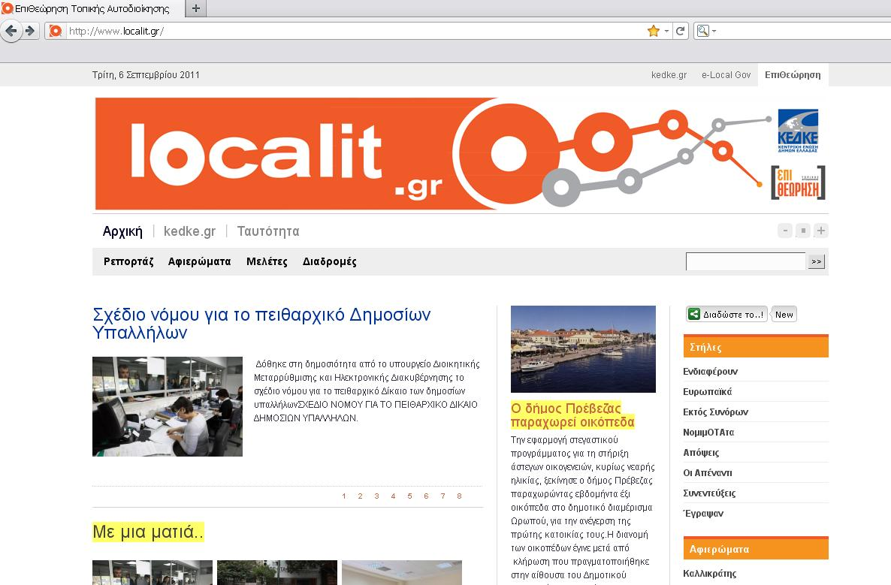
KEDE at press…
KEDE Journal continues the tradition of analytical information for the elected representatives, the personnel and the active citizens. It inspires innovation and good practice, illuminates aspects of legal, economic, institutional and other issues and creates occasions for reflection and dialogue, among those who are involves in Local Government
KEDE Journal, “Review of Local Government” goes on the Internet!
It covers current issues related to Local Government, but also relies on primary research, recording, charting and evaluating the policies introduced in Greece, Europe and elsewhere

Slide 32

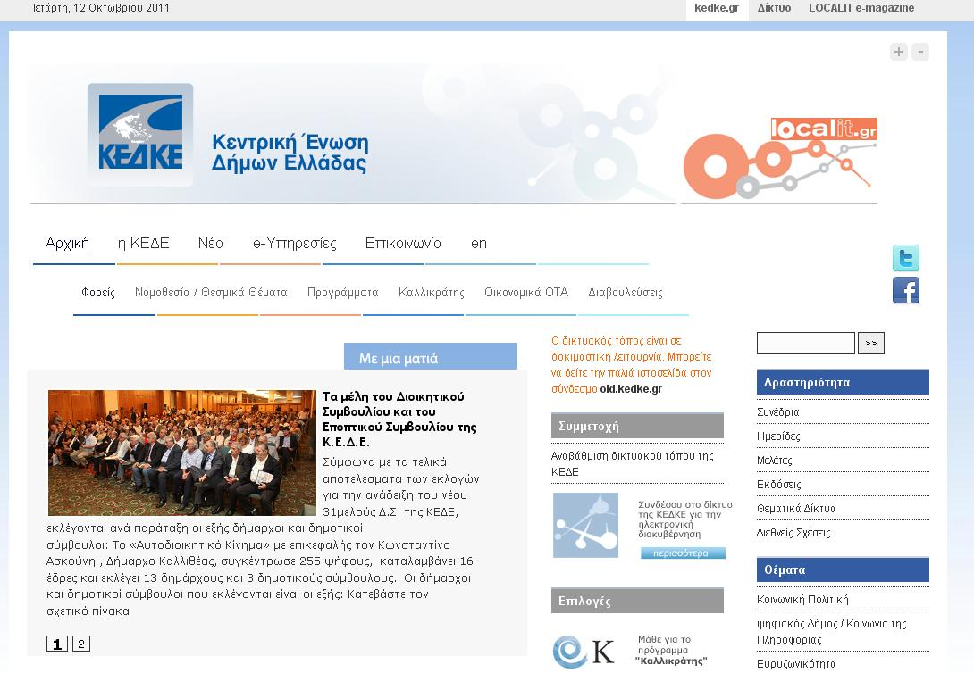
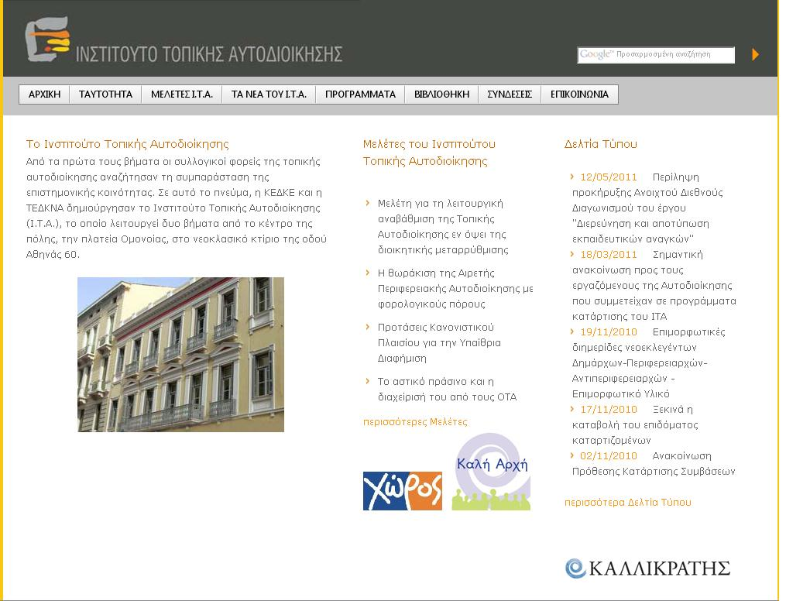
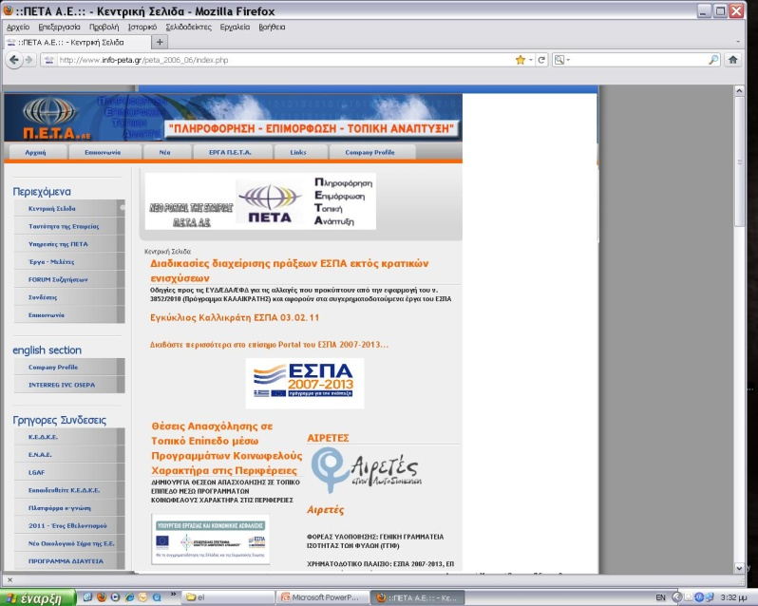
Local Government on line…
www.kedke.eu
www.eetaa.gr
www.info-peta.gr
www.ita.org.gr

Slide 33
For any further information please do not hesitate to contact us
Central Union of Municipalities of Greece (KEDE)
Akadimias 65 & Gennadiou 8,
Athens, 10678
Greece
Web: http://www.kedke.eu
E-mail: info@kedke.gr
Tel: + 30 213 214 75 00
Fax: + 30 210 38 99 651

Slide 34

Thank you for your attention!

